Slide 1

Management skills for business analysts ambiguity
Ms. Kati Julow

Slide 2

readings
https://www.batimes.com/articles/20-lessons-learnt-over-20-years-of-doing-business-analysis.html
Pulse of Profession report 2020
https://www.pmi.org/-/media/pmi/documents/public/pdf/learning/thought-leadership/pulse/pmi-pulse-2020-final.pdf?v=2a5fedd3-671a-44e1-9582-c31001b37b61&sc_lang_temp=en
A case on ambiguity”: https://uxdesign.cc/ambiguity-an-information-architecture-case-study-6e2608ac8de1
Supplementary about card sorting/ (https://www.nngroup.com/articles/card-sorting-definition/)
„life-lessons from a BA”: https://www.batimes.com/articles/20-lessons-learnt-over-20-years-of-doing-business-analysis.html

Slide 3
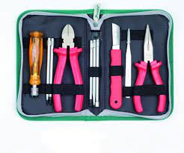
How to handle ambiguity?
Your takeaways and toolset:
BA role
Sources of uncertainty
How can you map your partner?
Pacing-leading
Active listening
VAKOG
Mirrorring

Slide 4

How do you wish to be remembered….?

Slide 5

Group discussion: what does a business analyst do?

Slide 6
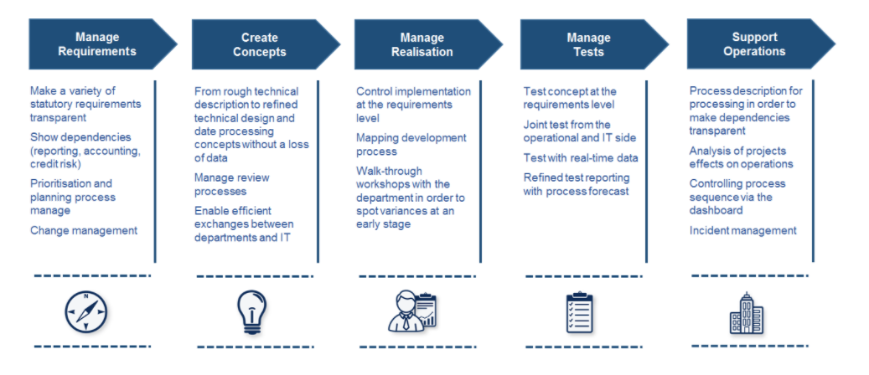
What does a business analyst do? (1)
Notes:
Ű

Slide 7
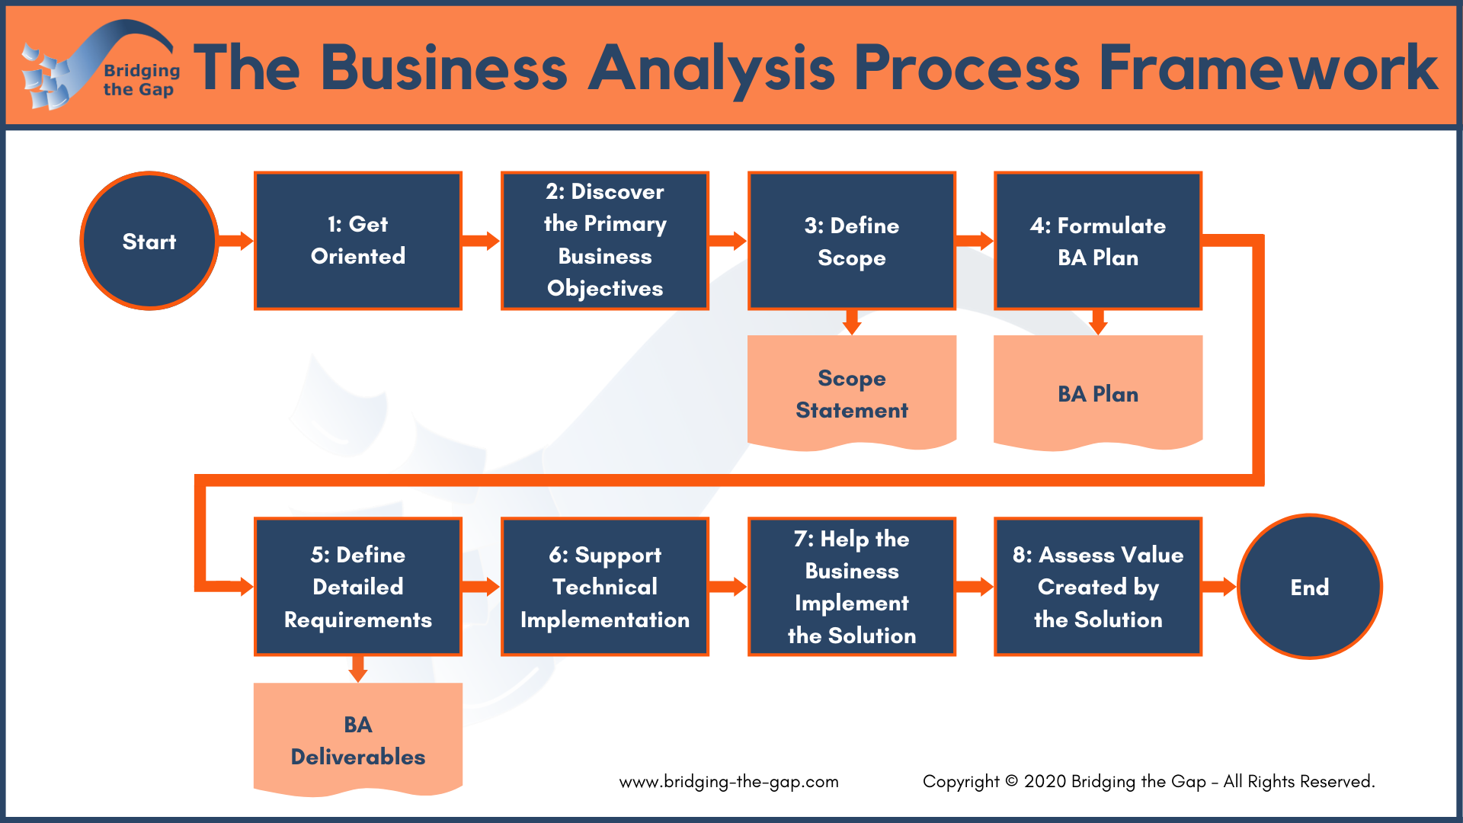
Business analysis process

Slide 8
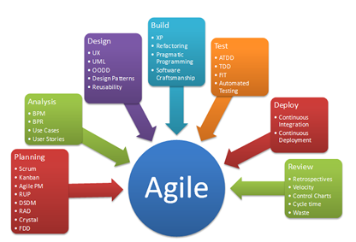
What does a business analyst do? (3)

Slide 9
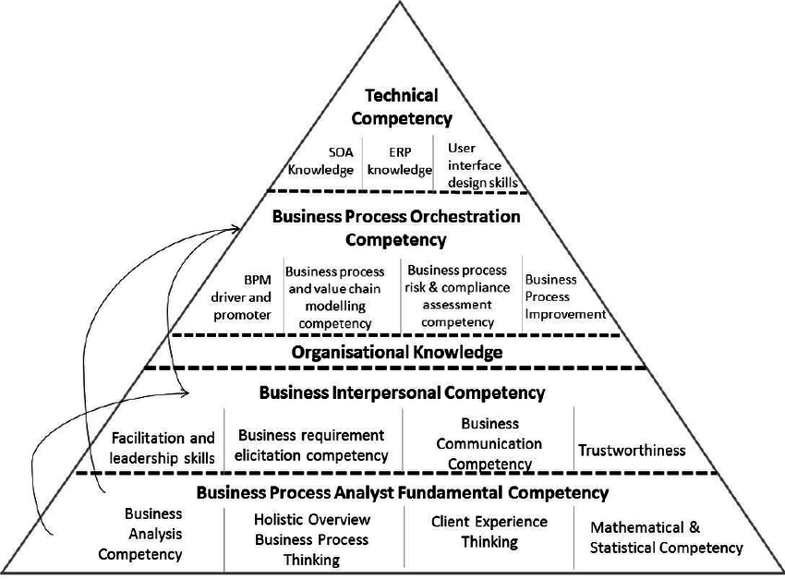
What does a business analyst do? (4)

Slide 10
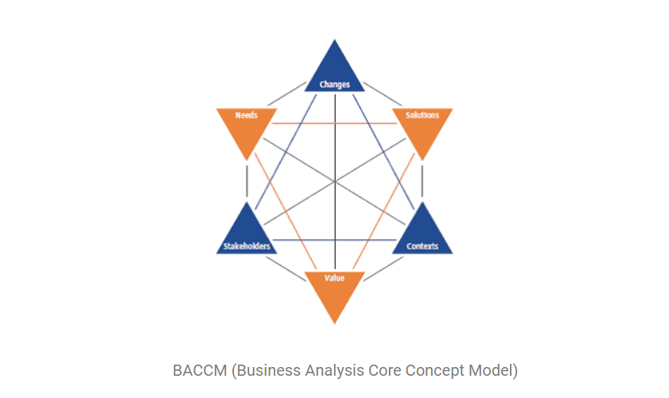

Slide 11
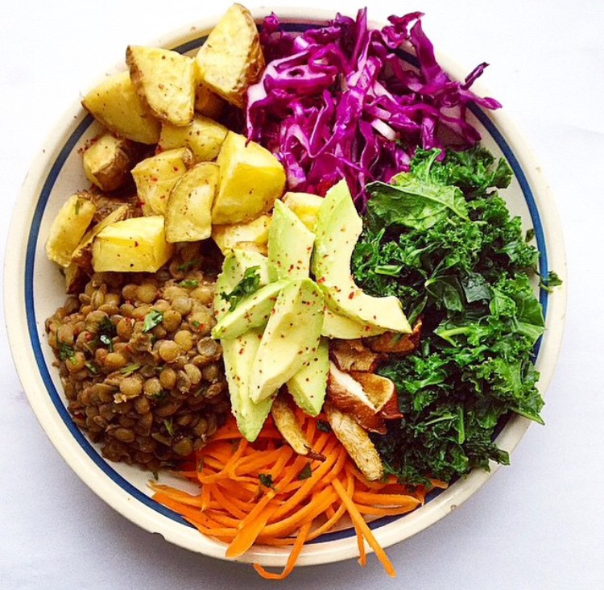
So, in a brief….. (What does a business analyst do?) increases value elicitates information analyses information ensures requirement-strategy-objectives are matching glues stakeholders
Notes:
You have a lot on your plate
However all this much you do in ambiguity and uncertainty.

Slide 12

How does uncertainty feel?
Notes:
Business analysts face many uncertainties, ambiguous project content, or work with a predefined project where they may lack clarity. We explore what are the benefits of uncertainty, how to handle stress, anger; how to keep self-confidence; what resources can we build on, and how can we get into “control” through communication (pacing-leading; mirroring, raising questions, etc.), how to discover primary business objectives? How to clarify your role? How to assess your resources? (project/org, history; available info

Slide 13

 | champions | laggards
Proportion of completed projects | 88% | 24%
Completed projects within budget | 90% | 25%
Projects fulfilling business objectives | 92% | 33%
PMI 2017 Pulse of Profession survey

Slide 14
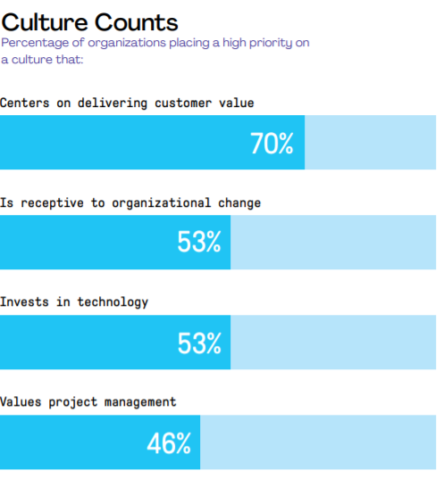
PMI 2017 Pulse of Profession survey

Slide 15
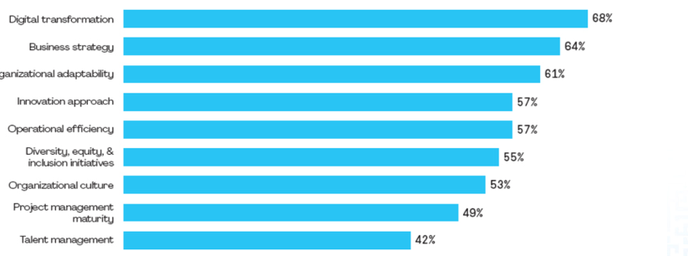
What key changes are observable?
last year vs 2 yrs ago

Slide 16

What can be the source of uncertainty for me, as a BA? Pair up and list reasons (3 minutes)

Slide 17
What can be the source of uncertainty?
My uncertainty? (self-awareness)
Organizational fear?
Management incompetence?
Rapidly changing policies?
Conflicting messages/wants?
Inexperienced people?
Inexperienced me?
Lacking feedback?
Unclear objectives?

Slide 18

How can we reduce our uncertainties?

Slide 19
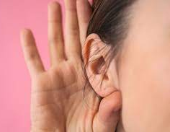
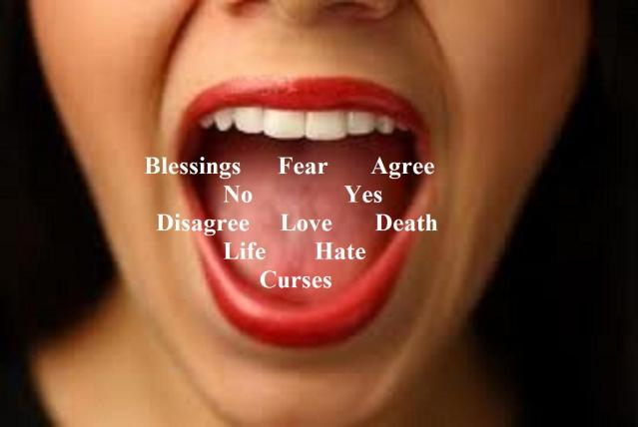


How to step into the ring?
Clarifying my role----
Clarifying my relevance (why I am here/how I will help/…..
Coping with pressure, stress (what is your fav coping technique?)
Assessing my resources
Create clarity by asking questions
Asking questions to monitor understanding, interpretation
Bonding and building trust

Slide 20
Active listening
What do you do when you actively listen?
(What should you avoid?)
A wise old owl lived in an oak, The more he saw, the less he spoke The less he spoke, the more he heard, Now, wasn't he a wise old bird?

Slide 21
Active listening exercise
Form groups of 3
A speaker
A listener
An observer
3 minutes speaking time (speaker pick any topic, start telling your story to listener.
Listener listen to the story- Observer: monitor the listener. Is the listener actively listening? (use a checklist)
A wise old owl lived in an oak, The more he saw, the less he spoke The less he spoke, the more he heard, Now, wasn't he a wise old bird?

Slide 22
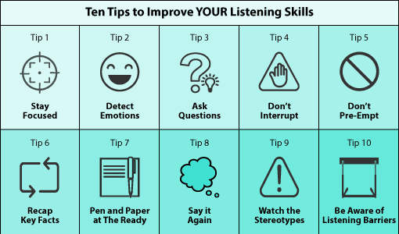
Active listening

Slide 23

mapping my partner
Write a 10 sentence brief about your current location. Where are you right now? How this ambiance feels? ….
You have 5 mins.
Notes:
VAKOG exercise.
Read your stories
Every body listens. The base of listening:

Slide 24
„mapping my partner”
Now read your story.
Audience: you actively listen.
Monitor expressions:
Visual (related to seeing, watching, sights, views, colors, brightness)
Accoustic: sounds, silence, hearing, noise, tone
Kinestetic: touch, weigh, surface, materials,
Olfactory: smelling, odour, fragrance,
Gustatoric (taste)

Slide 25

What is VAKOG?
How do we store information?
How do we gather and retrieve information?
Sensory

Slide 26
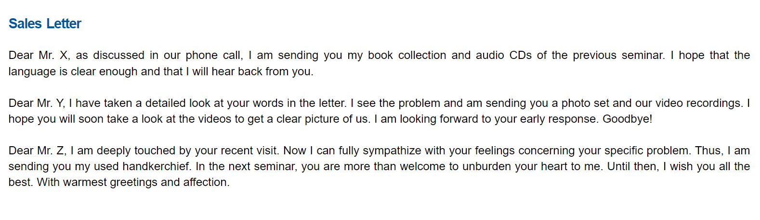
VaKOG EXAMPLE
https://www.landsiedel.com/en/nlp-library/representational-systems-vakog.html#exercises

Slide 27
„reflecting my partner” (mirroring)
Why do you need to mirror?
How is that happening?

Slide 28
„getting into the driver seat” (pacing-leading)
Why do you need to get into a driver seat?
How is that happening?

